Slide 1
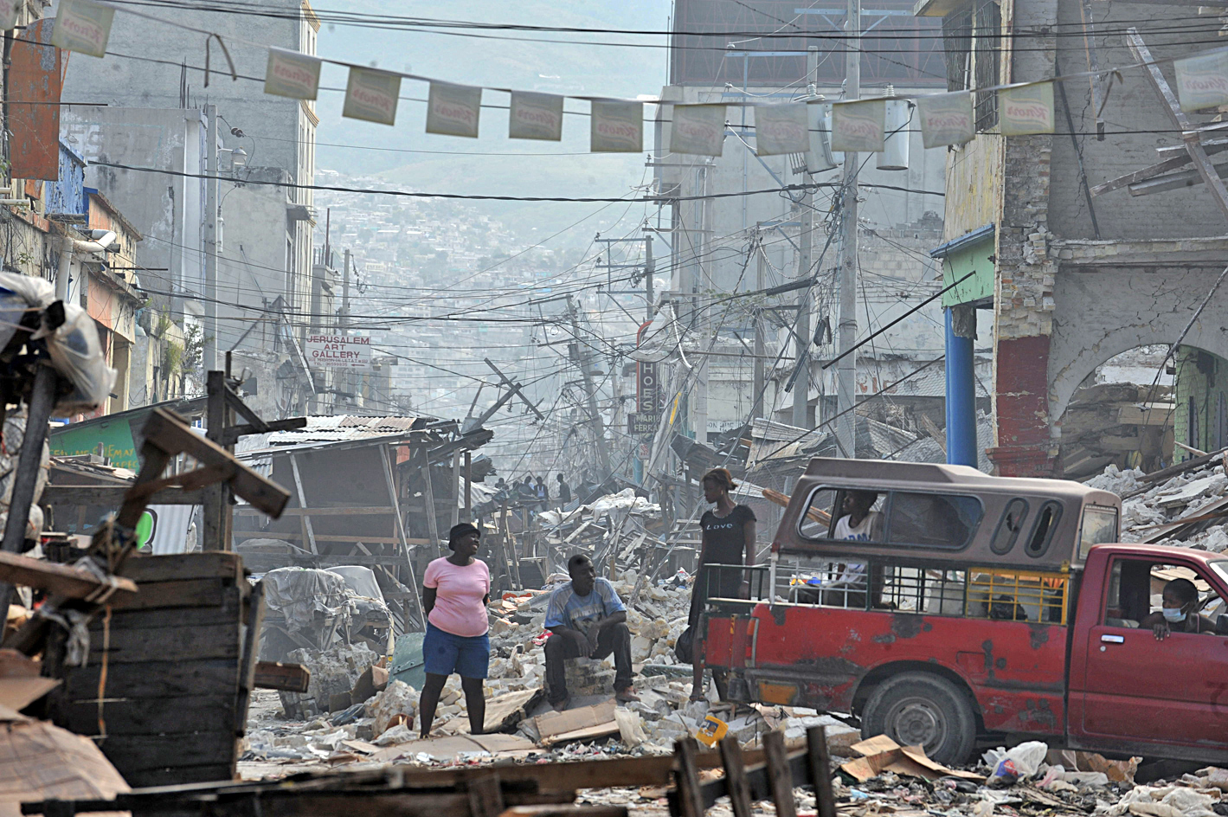
The effect of internal displacement from the 2010 Haitian earthquake on long-term violence against children
Promising methodologies for measuring social and health outcomes
Ilan Cerna-Turoff
London School of Hygiene and Tropical Medicine
Notes:
Photo credit: RIBI Image Library. 2010. Haiti Earthquake. Accessed 02 Sept 2017 from: https://www.flickr.com/photos/91311153@N02/8293453133.

Slide 2
Acknowledgements
Dr. Jeremy C. Kane, Johns Hopkins University
Dr. Karen Devries, London School of Hygiene and Tropical Medicine
Dr. James Mercy, U.S. Centers for Disease Control and Prevention
Dr. Greta Massetti , U.S. Centers for Disease Control and Prevention
Dr. Mike Baiocchi, Stanford University

Slide 3
Case study:
Internal displacement from the 2010 Haitian earthquake
CDC’s Violence Against Children Survey
Nationally representative survey of physical, emotional and sexual violence
Separated by boys and girls
Sample of 13-17 year-olds

Slide 4
Notes:
Figure credit: JSAID. 2010. USG Humanitarian Assistance to Haiti for the Earthquake. Accessed 02 Sept 2017 from: https://dec.usaid.gov/dec/GetDoc.axd?ctID=ODVhZjk4NWQtM2YyMi00YjRmLTkxNjktZTcxMjM2NDBmY2Uy&rID=MzMwNDU0&pID=NTYw&attchmnt=VHJ1ZQ==&uSesDM=False&rIdx=NDI4Nzk2&rCFU=

Slide 5
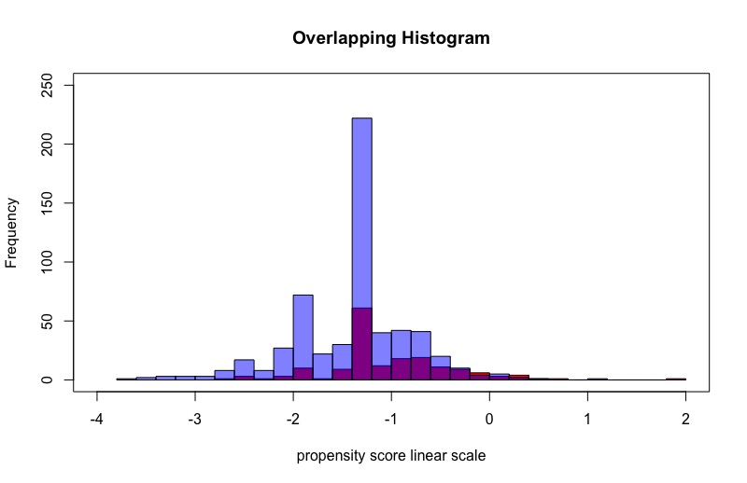

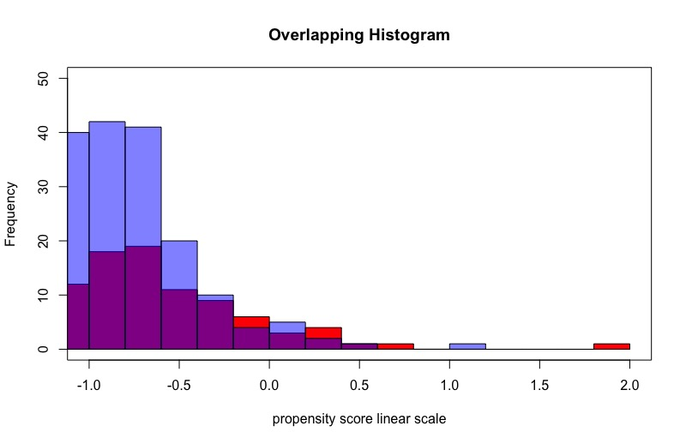
Matching displaced and non-displaced children

Slide 6
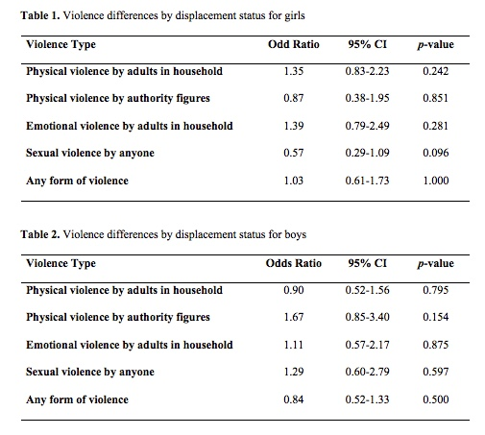
Results

Slide 7
Implications
Accurate measurement and depth of understanding is necessary in meeting SDG 16.2
Time trends, context of displacement, and details on violence are key for future research in building more targeted and effective interventions for children
We created a high-quality, logistically feasible and cost-saving statistical framework for low-resource settings

Slide 8
Questions and future collaboration
Contact:
Ilan Cerna-Turoff
it2208@caa.columbia.edu

