Slide 1

Serge Stroobants
Director Europe and MENA
Climate Change and Positive Peace
IDMC Conference 2019
Geneva, 01 October 2019

Slide 2
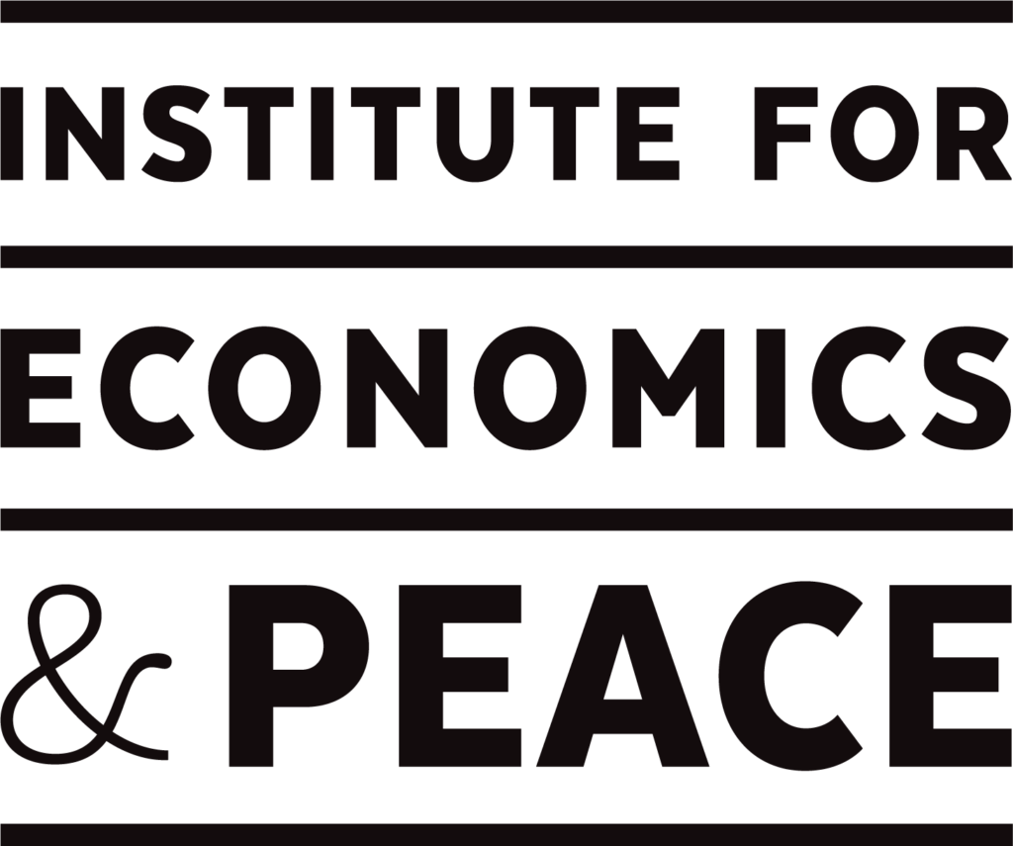
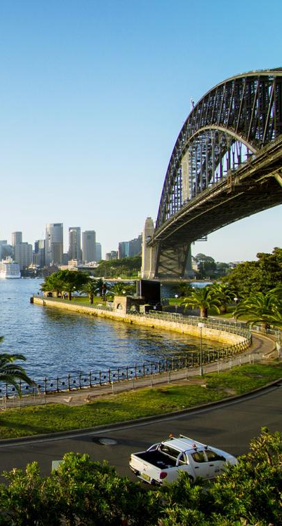

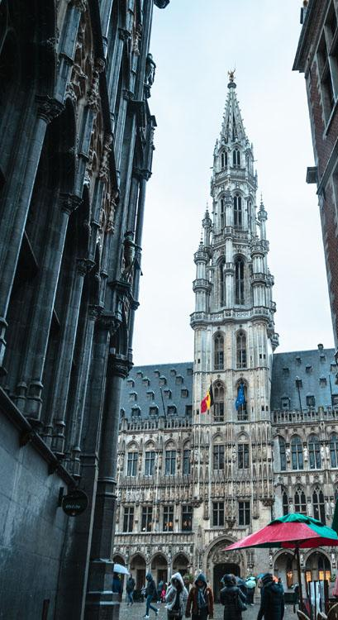
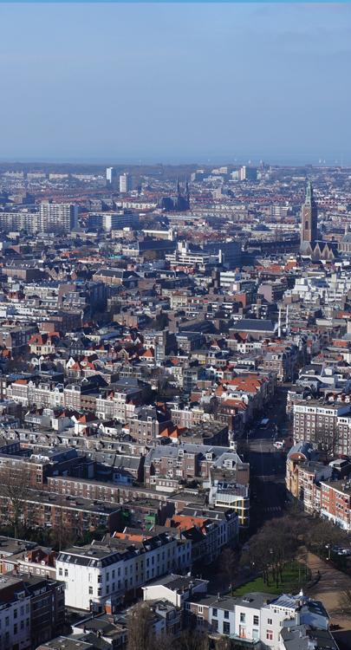
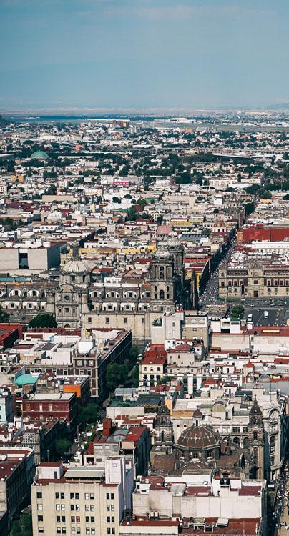
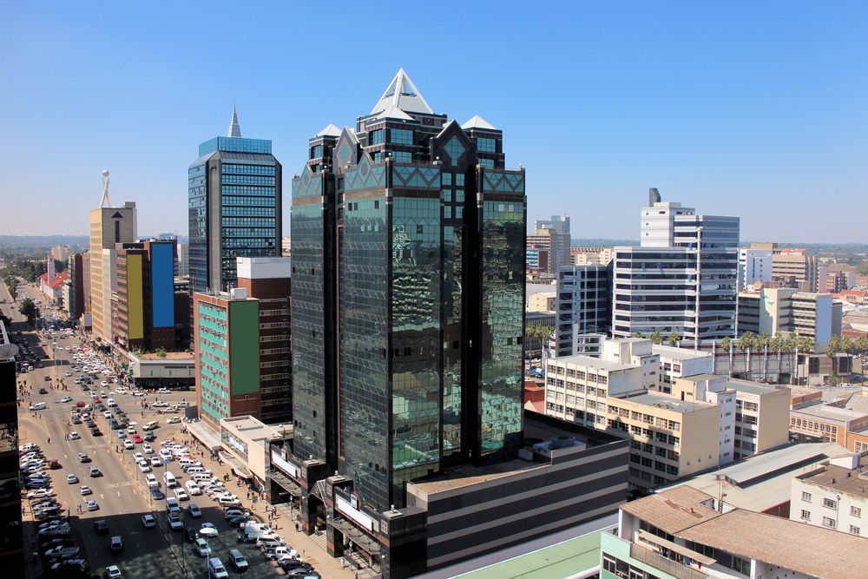
IEP International Offices
SYDNEY
NEW YORK
BRUSSELS
THE HAGUE
MEXICO CITY
HARARE
Australia
USA
Belgium
The Netherlands
Mexico
Zimbabwe

Slide 3
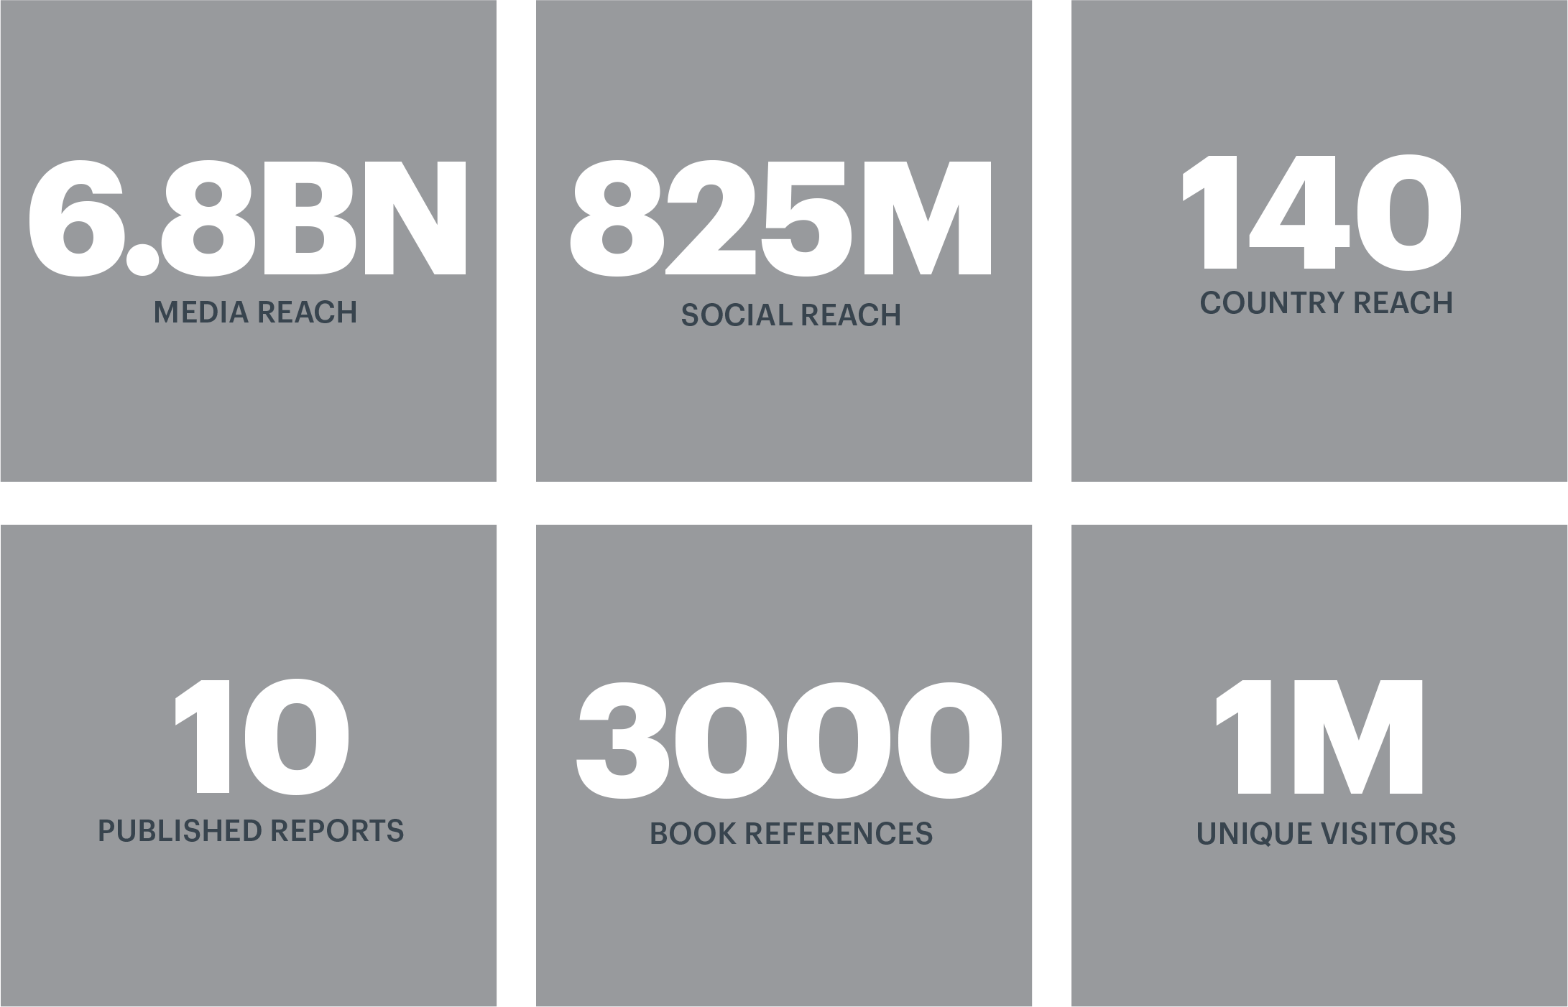
Institute for Economics & Peace
4
Research used extensively by organisations including the OECD, Commonwealth Secretariat, World Bank and the United Nations.
7BN
Work is included in 1,000s of university courses and trained over 1,100 IEP ambassadors.
Over 100,000 downloads of IEP reports last 12 months.

Slide 4
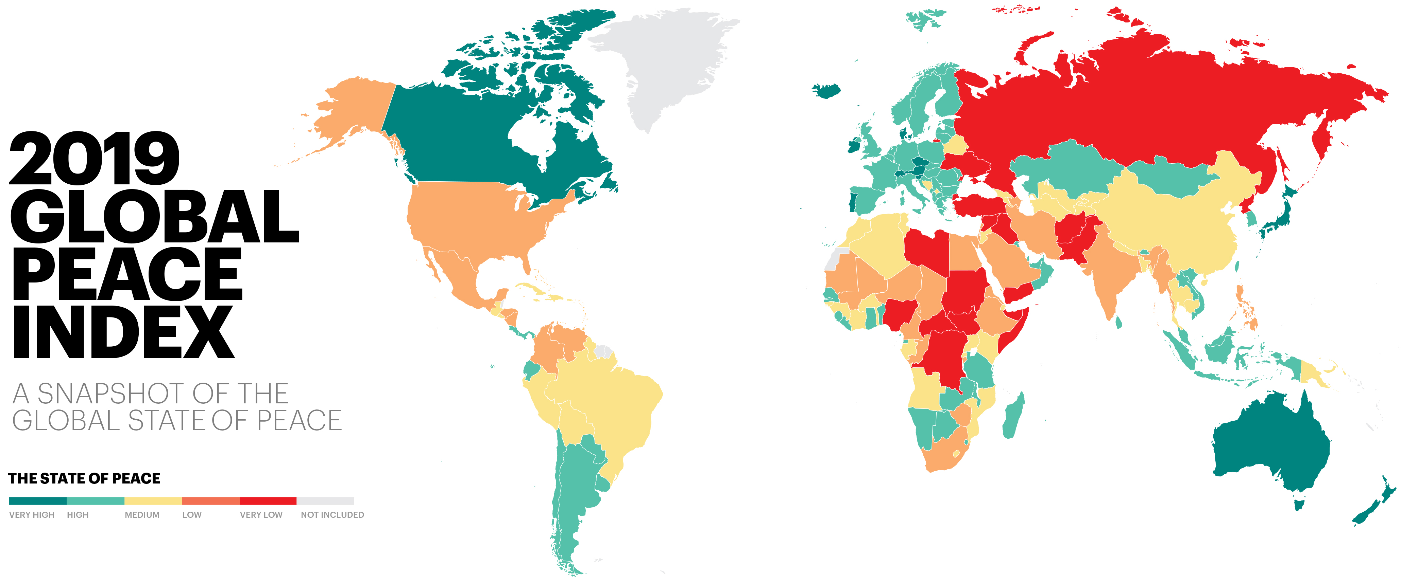

Slide 5
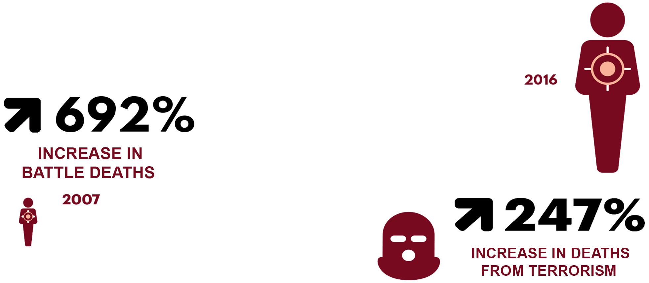


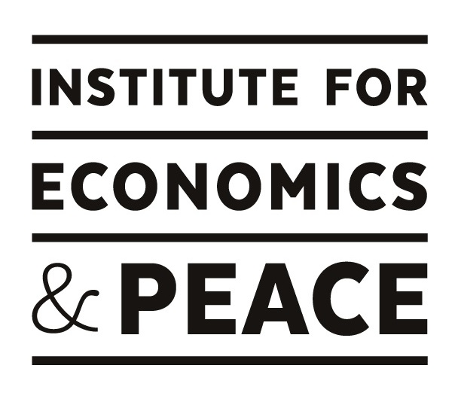
Deteriorations in peace - 10 years
163
2018
251%
2008
203%
60 million in 2017
70 million in 2019

Slide 6
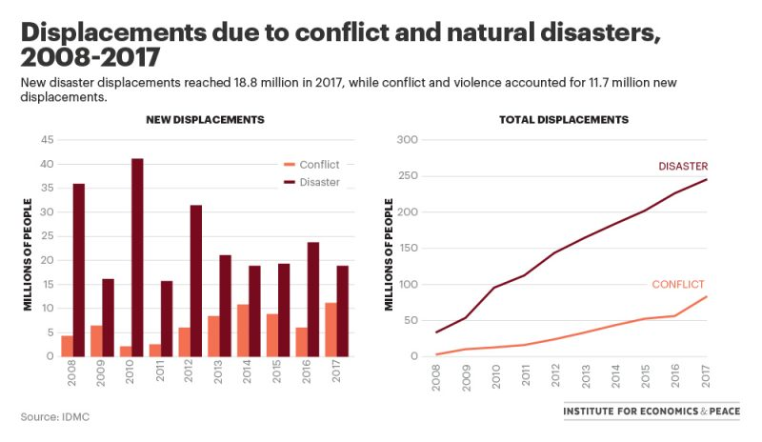

Slide 7
The stickiness of peace
    Gap between the least and most peaceful countries continues to grow

Slide 8
Climate change and peace
    971 million people live in areas with high or very high climate change exposure. 400 million reside in countries with low levels of peacefulness.
    Climate change can increase the likelihood of violent conflict through its impact on resource availability, livelihood security and migration.
    Countries with high levels of Positive Peace are better able to manage climate-induced shocks and tend to have higher environmental performance

Slide 9
Climate change and Positive Peace
    Countries with low levels of Positive Peace have lower levels of cooperation, lower environmental performance, and suffer more casualities from natural disasters.

Slide 10
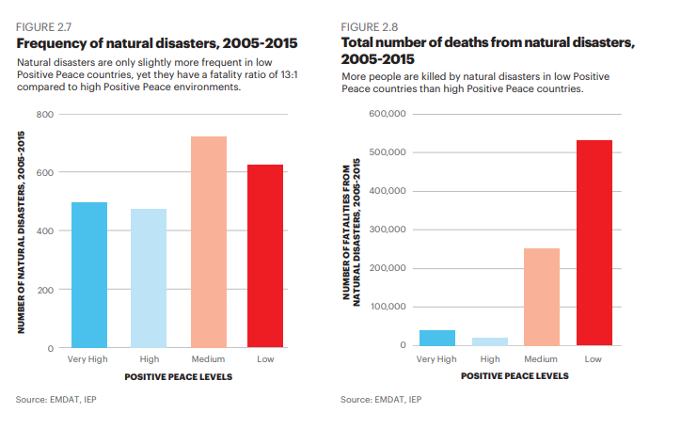
Climate change and Positive Peace

Slide 11
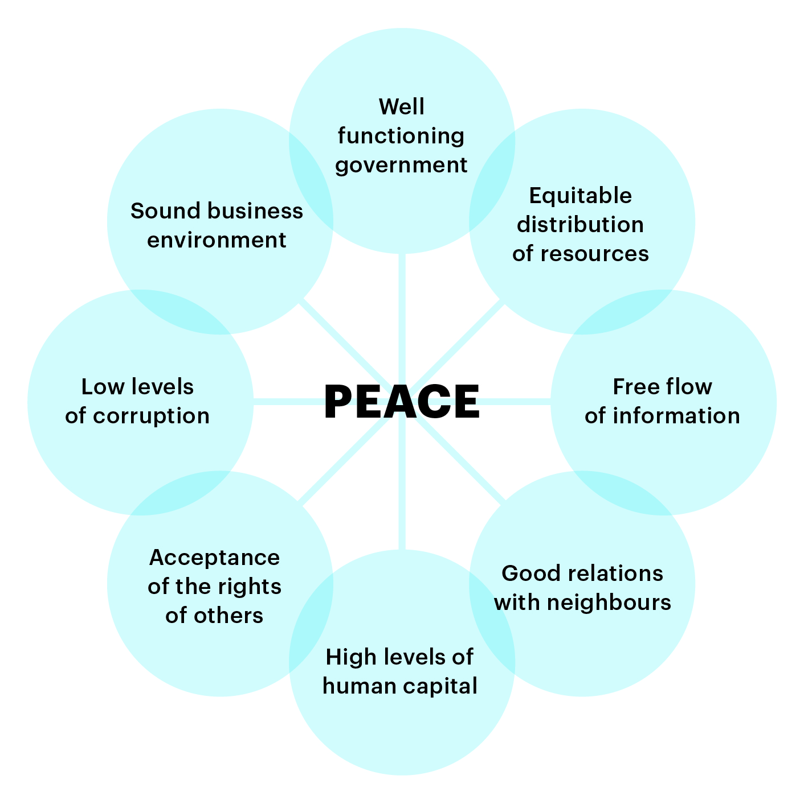
Positive Peace
    Positive Peace creates the optimum environment for human potential to flourish.
    High levels of Positive Peace are associated with:
    Higher per capita income
    Resilience
    Better environmental outcomes
    Higher GDP growth per annum
    Better performance on SDGs

Slide 14
The global cost of violence, 2019
    Deaths from conflict and terrorism peaked in 2014.
$14.1
TRILLION
Which is equivalent to
11.2%
of total world GDP OR
$1853
per person
If the world decreased
violence by 10%...
$1.41 TRILLION
Could be directed to
other economic activities
    *This is a highly conservative estimate.

Slide 15
Breakdown of the economic impact of violence
    Military expenditure accounts for over 40% of the total economic impact of violence.
A 1% reduction in the cost of violence is the equivalent to:
163
total global Official Development Assistance in 2018
A 10% reduction in the cost of violence is the equivalent to:
The global total Foreign Direct Investment in 2018
The size the combined economies of Switzerland, Ireland and Denmark
Source: IEP

Slide 16


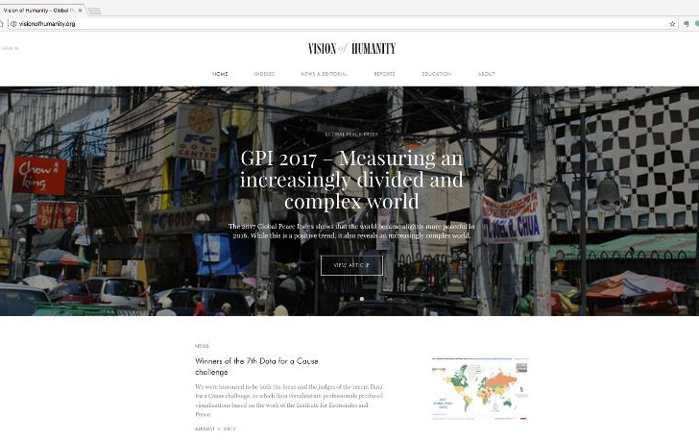

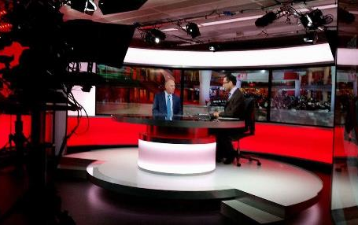
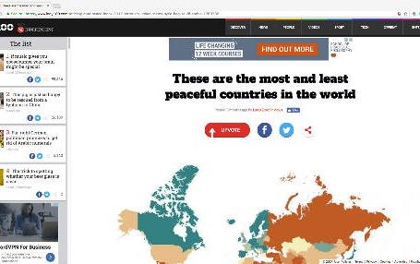
Connect with us
visionofhumanity.org
@GlobPeaceIndex
Explore peace indexes, peace research
and peace news and articles.
Keep up to date with the latest peace news.
GlobalPeaceIndex
@GlobalPeaceIndex
Like us on Facebook for articles, video and other peace related content.
Get the latest news and stories on Instagram.

