Slide 1
Ramani Huria: Community Mapping for Flood Resilience
@hawaadinani
Notes:
Local people, local devices, add open knowledge

Slide 2
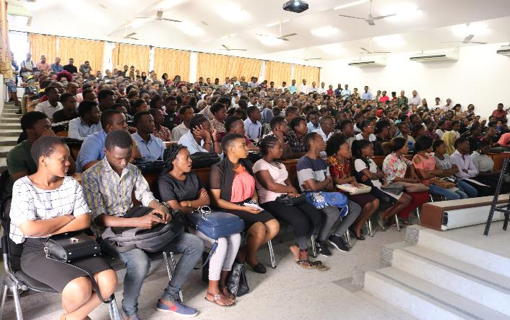
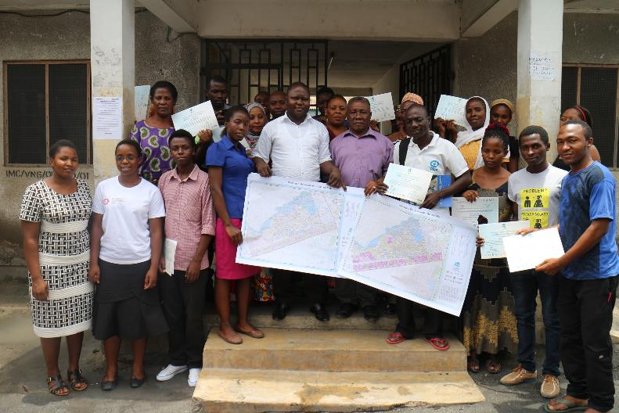
Introduction to Ramani Huria
University Students
Community Members
Notes:
Ramani Huria is a World Bank/DFID funded community-based mapping project that began in Dar es Salaam, Tanzania,
training university students and local community members to create highly accurate maps of the most flood-prone areas of the city.
Since its kick-off in 2015, RH has trained more than 1000 university students and worked with hundreds of community members to collect flood related data.

Slide 3
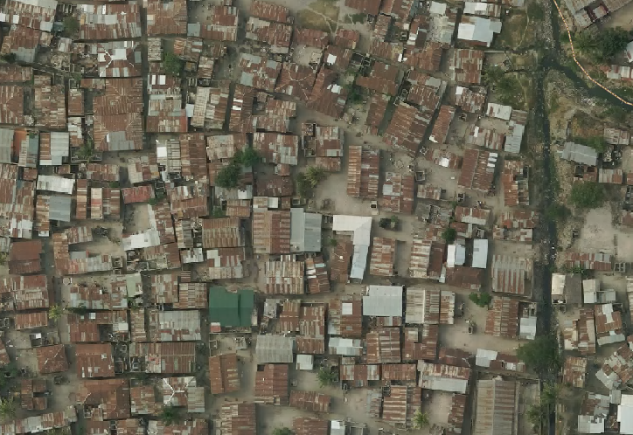
Why Mapping Dar es Salaam?
Rapidly growing city in Africa--Population approaching 5 million people
70% of the city is unplanned
Vulnerable to climatic variability--Heavy rainfall--Flooding
Infrastructure problems i.e Drainage systems
Ineffective waste management
Notes:
Basic services such as water, sanitation, electricity, drainage, roads, lighting, garbage collection are disturbed
Flooding Impacts: livelihoods, property damage, loss of life. Hardest hit are the poorest areas.

Slide 4
Why Mapping Dar es Salaam
We’re mapping Dar es Salaam to:
Major Challenges to increased city vulnerability are:
Data and information are lacking*
The urban and land use planning system in Tanzania is inadequate
There is a significant and widening infrastructure gap
FILL DATA GAP
Notes:
Trained people who can make impact to the future Tanzania

Slide 5
Ramani Huria Datasets
To address impacts, Strengthen resilience and reduce risk of flood impacts including displacement, Ramani Huria collected a number of datasets over the past four years
These data were collected with the great support of community members who are in risk and affected by flooding---Citizen/Community generated data

Slide 6
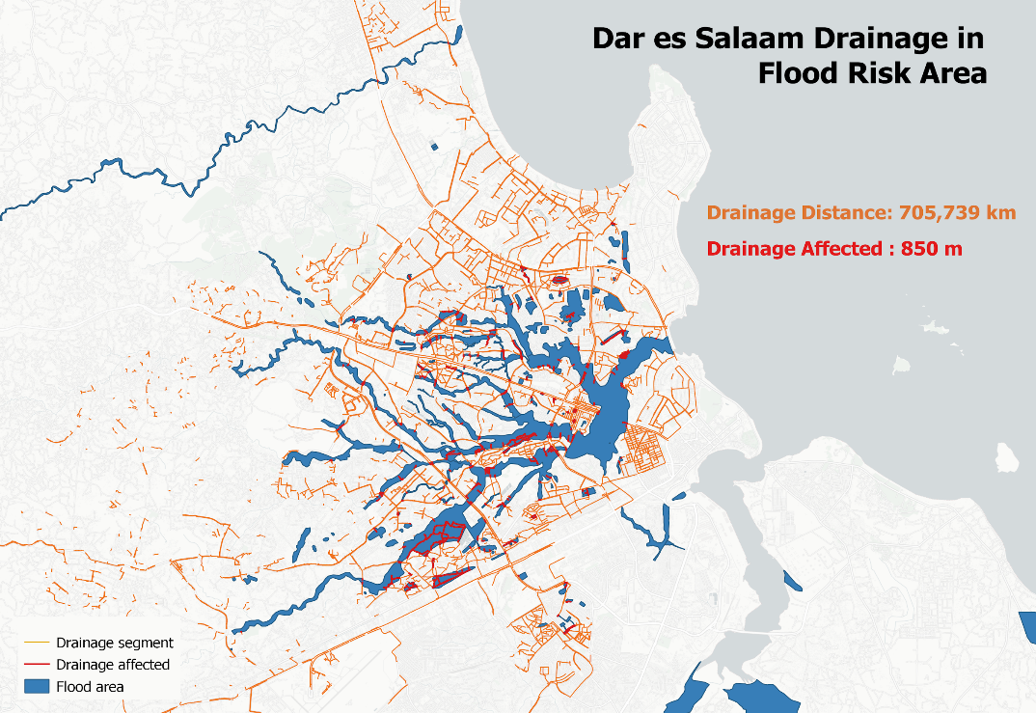
Ramani Huria Datasets; Drainage
Detailed drainage maps of 43 flood prone wards
Data is being used to develop detailed flood inundation models by our partner--Deltares
Notes:
Early warning--TMA
Through flood modeling
Support in evacuating

Slide 7
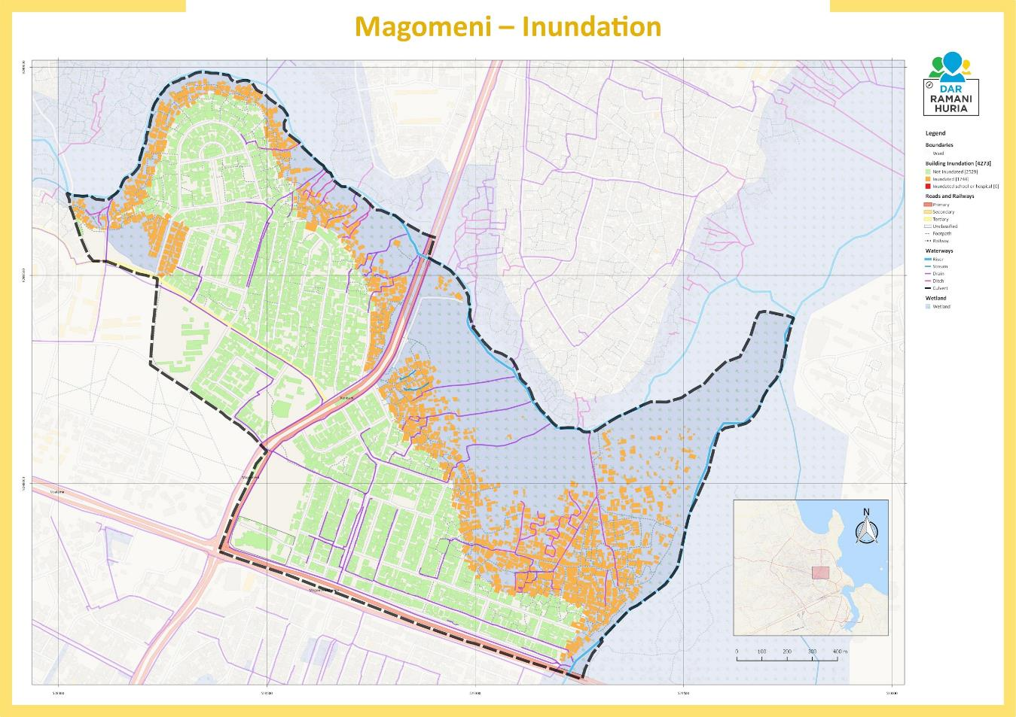
Ramani Huria Datasets: Inundation Maps

Slide 8
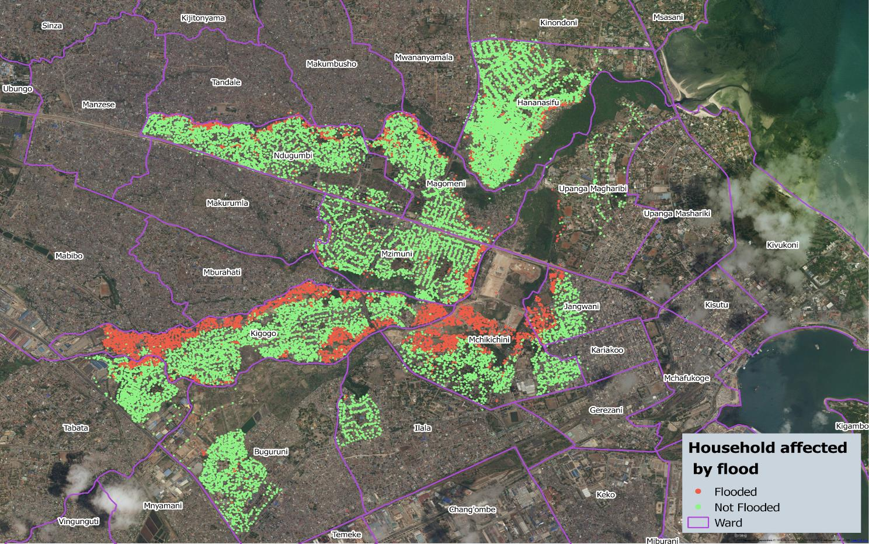
Ramani Huria Datasets; Flood Extent Mapping
Notes:
Surveys of experience of floods and the level of floods

Slide 9
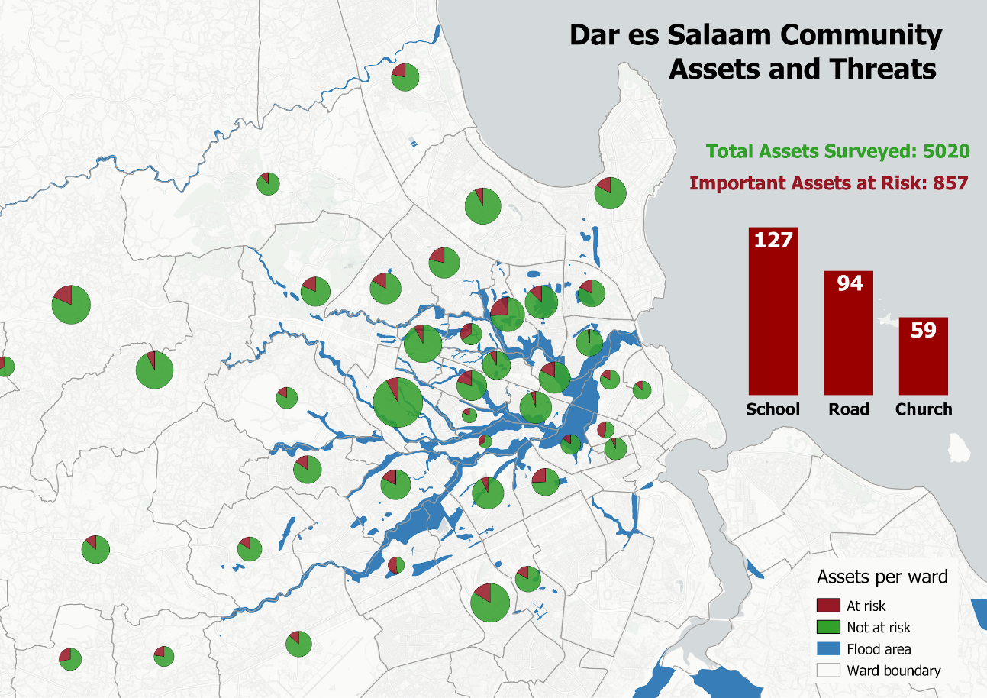
Ramani Huria Datasets: Asset & Threat Inventory
Notes:
Deltares will use data to prepare Flood resilience response plan to help on Risk reduction and Disaster management in ward and subward level

Slide 10
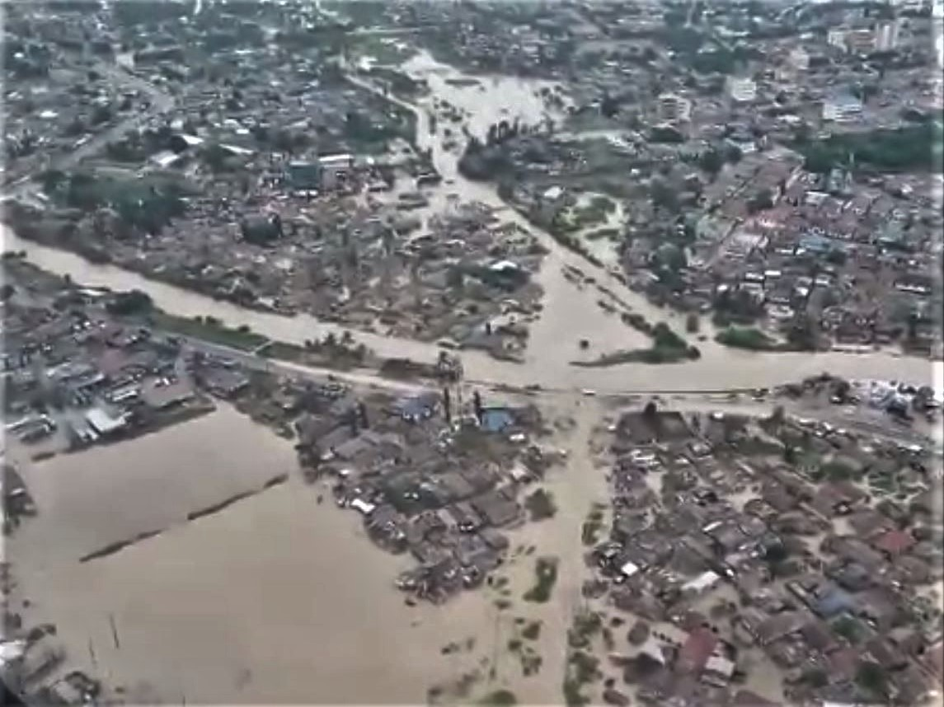
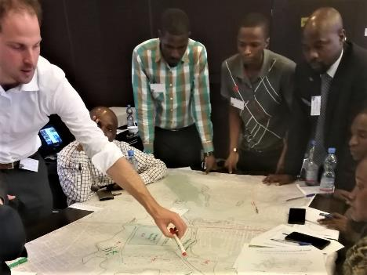
Applications and Data Use - Supporting Resilience Programs
Stakeholder in a plan for the Msimbazi River basin
Notes:
Creating a better life to community without relocating them

Slide 11
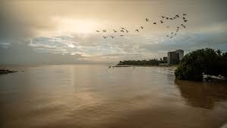
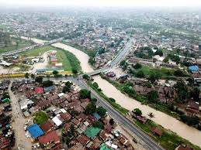
Historical Flood Extent--Data use
Supporting Resilience Programs cont….
Transforming the Msimbazi Basin into a Beacon of Urban Resilience--Msimbazi Opportunity
Notes:
Msimbazi is the most flooding river of the city--The development aims at restructuring the place without displacement/relocation

Slide 12
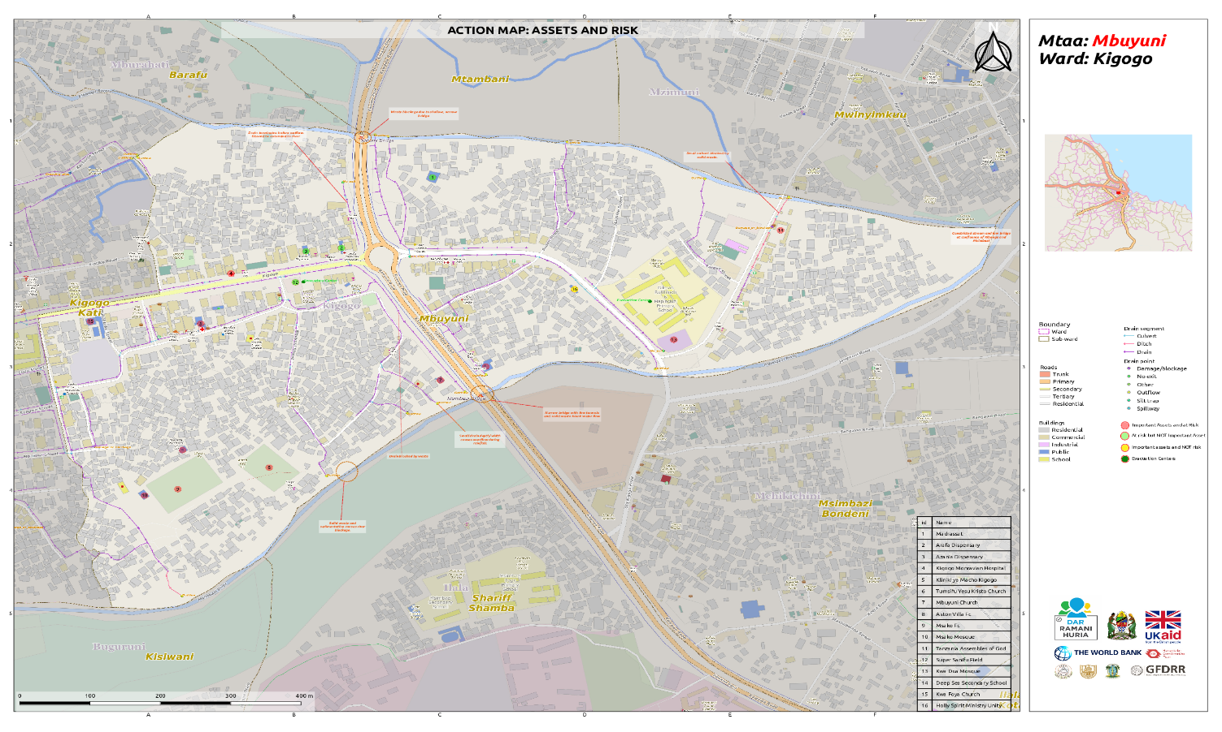
Applications and Data Use: Disaster Management Plans
Ramani Huria risk identification maps used as a basemap for disaster management plans

Slide 13
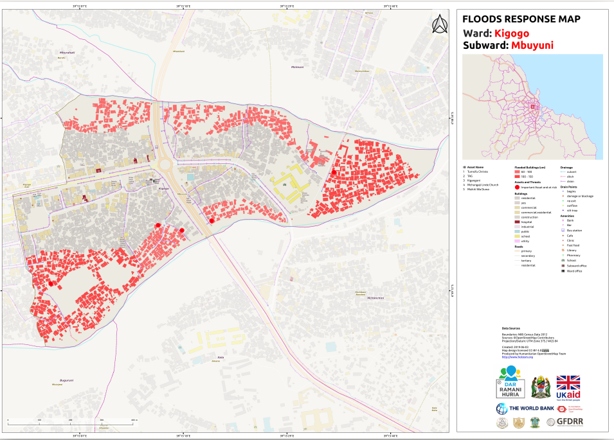
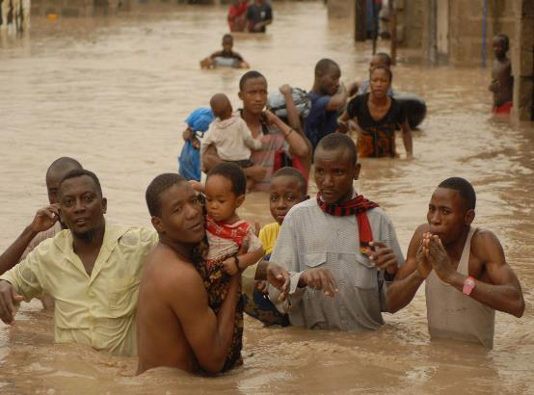
Applications and Data Use: Flood Response
Notes:
Before Ramani Huria, there was limited spatial data in Dar es Salaam that could be used to establish trends and assess impacts and damage caused by flooding.

Slide 14
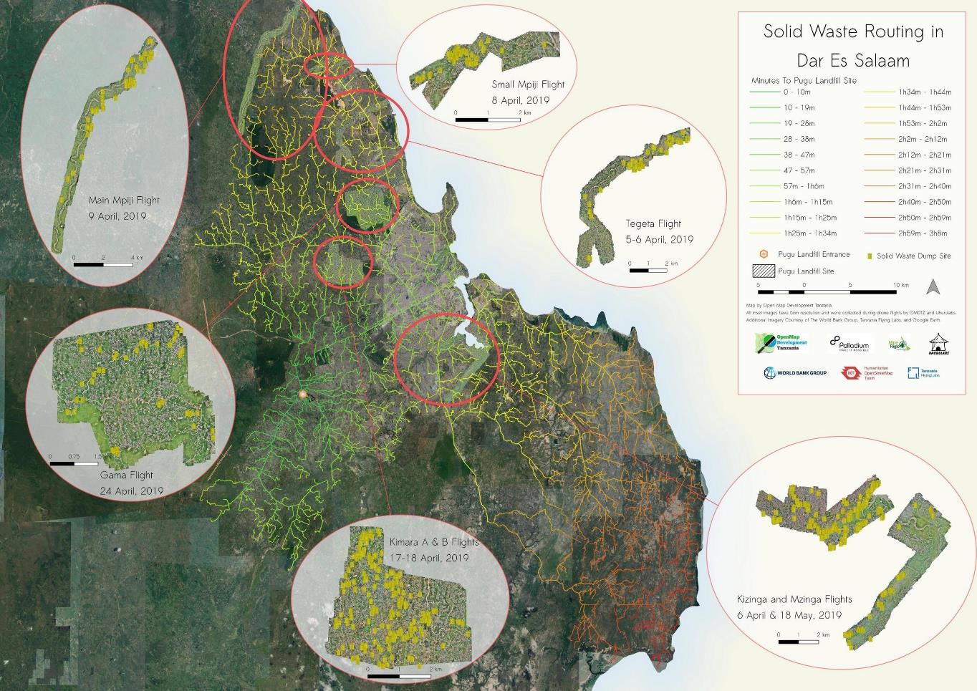
Applications and Data Use: Waste Management
Notes:
Developed solid waste routing in dar--analysis of best routes to the main dumping site
Identify other dumping sites

Slide 15
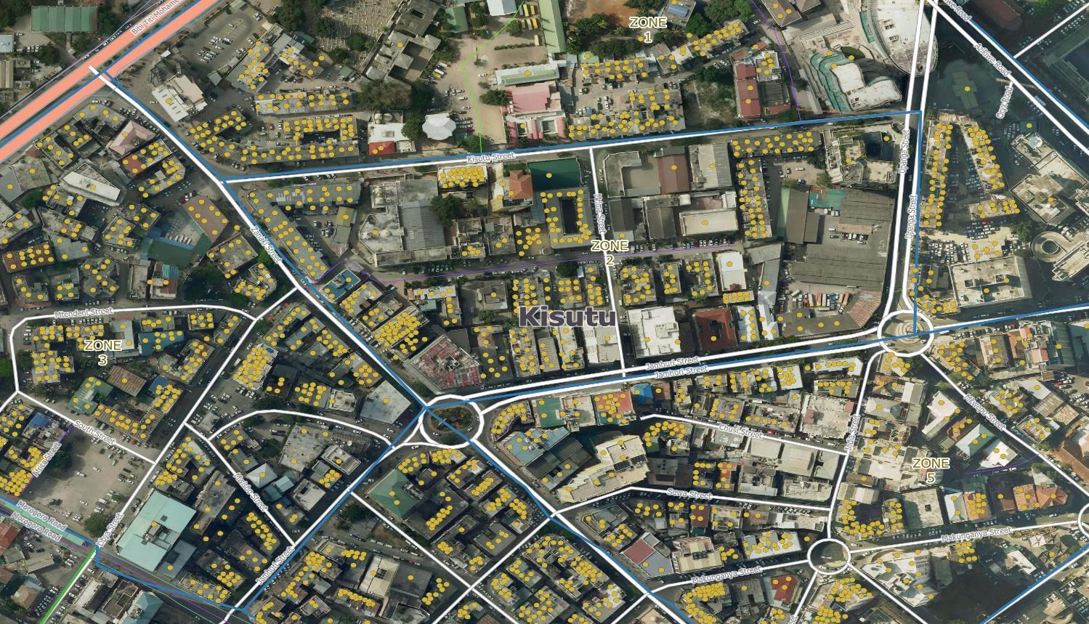
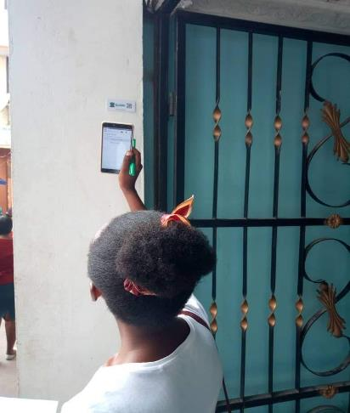
Applications and Data Use: Waste Management
Developed client tracking systems for trash collection companies
Notes:
Working with trash collection companies to develop clients tracking systems ie Green Waste Pro
Revenue have increased significantly and service improved.

Slide 16
Next Steps: Outreach and Engagement with Decision Makers
Capacity Buildings on data based decisions to:
Ministries
Disaster management committees ie.Prime Minister’s Office-Disaster Management Department
Local government authorities
Municipalities

Slide 17
Next Steps..Ongoing Impacts
World Bank and the UK Department for International Development have partnered with the Tanzanian government to help flood-prone communities identify and prioritize infrastructure needs, as one of a set of coordinated activities to improve preparation and respond to climate-related disasters under the Tanzania Urban Resilience Program (TURP)--Ramani Huria being within the program

Slide 18
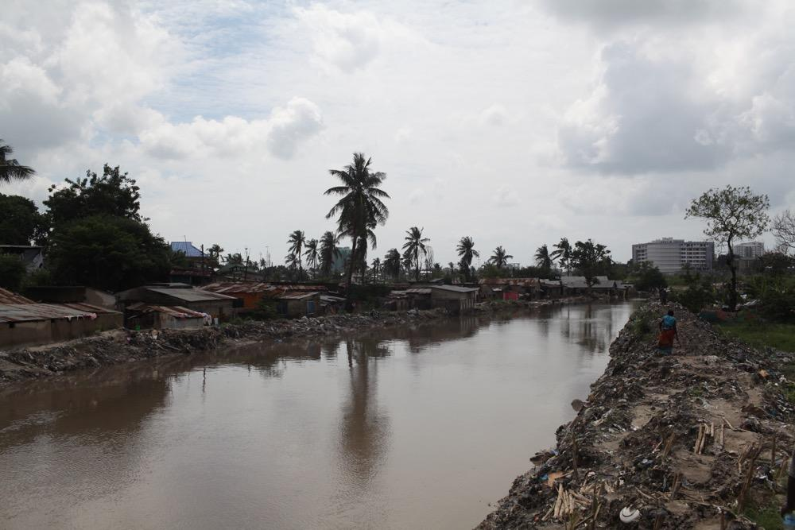
Conclusion
Residents of flood-prone areas are often among the poorest and most vulnerable. But they are not stupid. They make the best choices they can, given the constraints they face. It’s therefore important to ask a different question; what shapes their choices?.

Slide 19
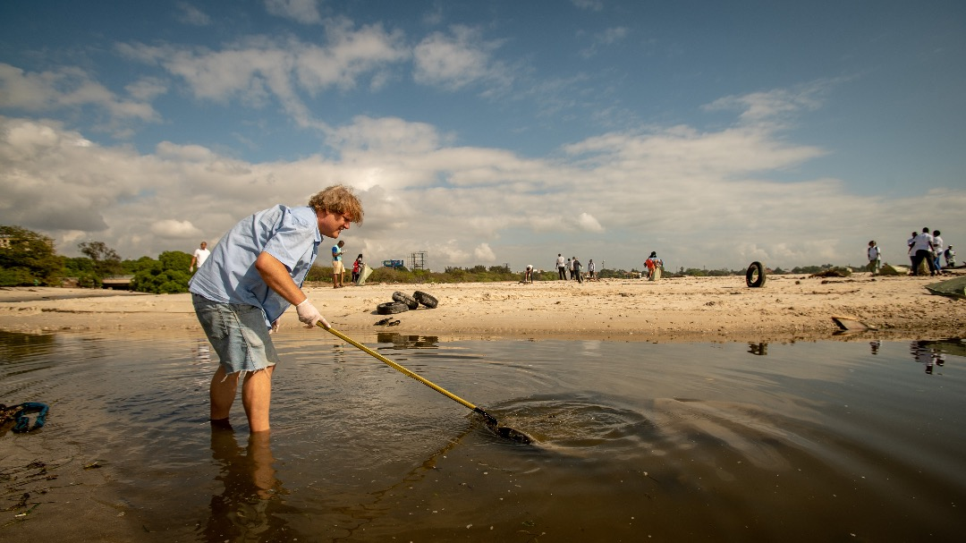
Conclusion
‘’To be on the map is to be acknowledged, it is to be known, it is to be recognized, it is to be counted. It is for the world to know that you are there and that you have needs, that you have dignity, that you have rights’’ Ivan Gayton--HOT-Tanzania Country Manager

Slide 20
Thank You
Follow us @hotosm | @ramanihuria
Join our mailing list at www.hotosm.org
www.ramanihuria.org
hawa.adinani@hotosm.org

