Slide 1
Facebook Disaster Maps & the Measurement of Long-Term Displacement
Eugenia Giraudy, Paige Maas, Shankar Iyer
(in close collaboration with IDMC)
Core Data Science @ Facebook
27 September 2019

Slide 2
Pressing Questions After a Crisis
Where are people going?
Houston, Texas during Hurricane Rita
(from Emergency Evacuation Wikipedia article)
Port Arthur, Texas during Hurricane Harvey
(from Hurricane Harvey Wikipedia article)
What places are most affected?

Slide 3
Disaster Maps Collaboration
+ several others…
+ many others
Paige
Eugenia
Laura
Alex
Andi
Alex
Sourav
Mercedes
Michal

Slide 4
Survey of Maps
FB Population: Locations with significant population changes
Movement: Pairs of places with significant movement changes
Connectivity: Outages in mobile phone service
Power Availability: Outages in electrical power availability
Long-Term Displacement:
From which places are people displaced?
Where do they go?
How long is it until they can come home?
All Disaster Maps must be easily causally interpretable, privacy protecting, and accurate.

Slide 5
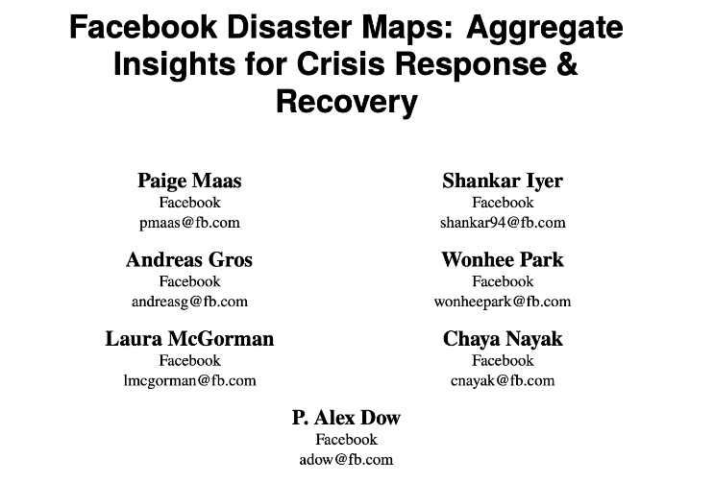
Real-World Applications
To distribute relief supplies
Respiratory masks during various California wildfires 2017-2018 (Direct Relief)
To set up WiFi hotspots
On Puerto Rico after Hurricane Maria (American Red Cross)
In Indonesia after earthquake in Sulawesi (UN Emergency Telecommunications Cluster)
To estimate the reach of emergency communications
In Indonesia after earthquake in Sulawesi (UNICEF)
To time a nationwide collection drive for donations
In India after flooding in Kerala (SEEDS)
ISCRAM 2019

Slide 6
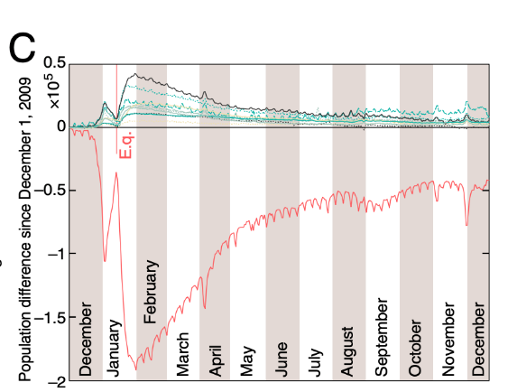
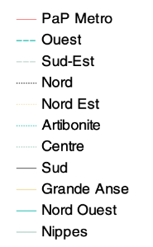
Long-Term Displacement Motivation
Mission: To provide high-quality data, analysis and expertise on internal displacement with the aim of informing policy and operational decisions that can reduce the risk of future displacement and improve the lives of internally displaced persons (IDPs) worldwide.
Cell phone data provides estimates of displacement from Port au Prince to other regions after 2010 Haiti earthquake.
Can Facebook data provide these types of estimates at scale for crises across the world?

Slide 7
Location History Data
Opt-in setting in the Facebook app, where people consent to sharing locations in exchange for location-based services (e.g., nearby WiFi)
High frequency, highly precise location estimates, comparable to GPS data
Enabled for roughly 15% of FB users worldwide
Discarded entirely from Facebook servers after 45 days
Location History data is anonymized and aggregated to build all Disaster Maps

Slide 8
Intuition for Methodology
Hypothetical Person #1
Hypothetical Person #2
Movements consistent with baseline mobility -> Never Displaced
Movements inconsistent with baseline mobility -> Displaced -> Returned
= pre-crisis locations
= immediate post-crisis locations
= long-term locations
Mobility Consistency Criteria
Inferred Home (based on pre-crisis period)
Typical deviation from home (based on pre-crisis period)
Is the deviation from home in the immediate post-crisis period inconsistent with pre-crisis mobility?

Slide 9
Displacement Methodology: Transition Matrix
home city
home country
status
current city
current country
number of people
Directly reported transitions
city 1
country A
displaced
city 2
country A
>= 10
Country-level aggregation
city 1
country A
displaced
country A
country A
sum of < 10 counts
Across border aggregation
city 1
country A
displaced abroad
displaced abroad
displaced abroad
sum of all counts
Directly reported never displaced
city 1
country A
never displaced
never displaced
never displaced
>= 10
Directly reported returned
city 1
country A
returned
returned
returned
>= 10
Redacted returned
city 3
country B
returned
too few to report
too few to report
NA

Slide 10
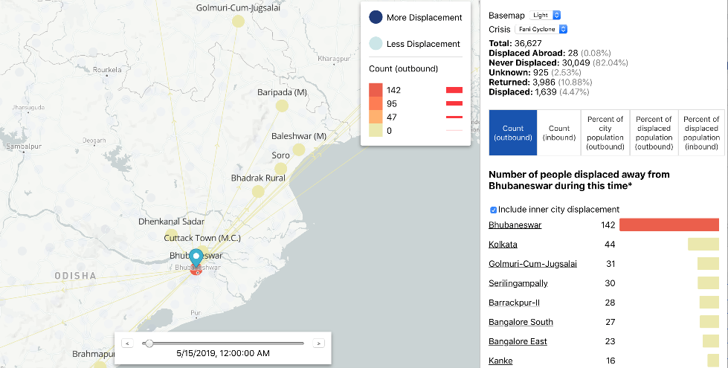
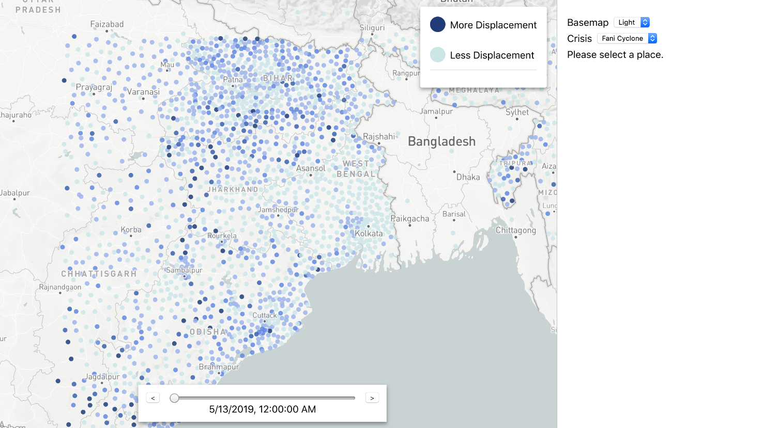
GeoInsights: Secured Tool for Map Sharing

Slide 11
Disaster Map Requirements
Causally interpretable
Movements in the transition matrix can be interpreted as the causal effect of the crisis.
Easily interpretable
Partners can directly read the dominant destination cities for displaced people from the transition matrix.
Privacy Protecting
We only use opt-in data that we store for short periods of time (1.5 months), only share aggregations of that data, obscure transition counts that are too low, and never report cross-border migration.
Accurate?

Slide 12
Cyclone Fani: Synopsis [Source: https://en.wikipedia.org/wiki/Cyclone_Fani]
Made landfall in Odisha in India at 8am on May 3
Most intense cyclone in Odisha since 1999
At least 89 fatalities and $8.1 billion in damages, spread across India and Bangladesh but concentrated in Odisha
Authorities in the two countries evacuated at least 1.2 million people from the path of the cyclone to higher ground and / or shelters

Slide 13
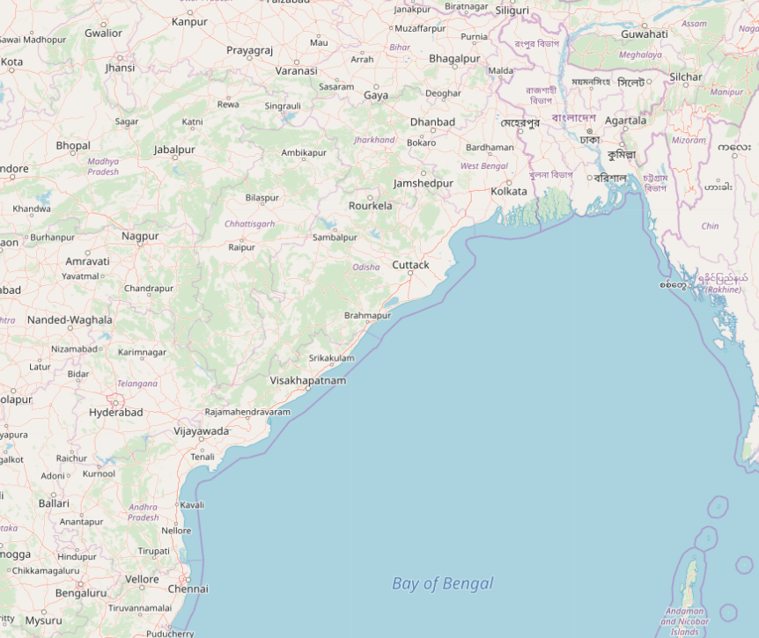
Cyclone Fani: Cities by Displacement Level
Migration pattern across Eastern India and Bangladesh is consistent with what is known about the crisis.

Slide 14
Cyclone Fani: Displacement + Return Over Time
We observe a clear ”return” signal in the weeks after the cyclone, without masking by confounding effects.

Slide 15
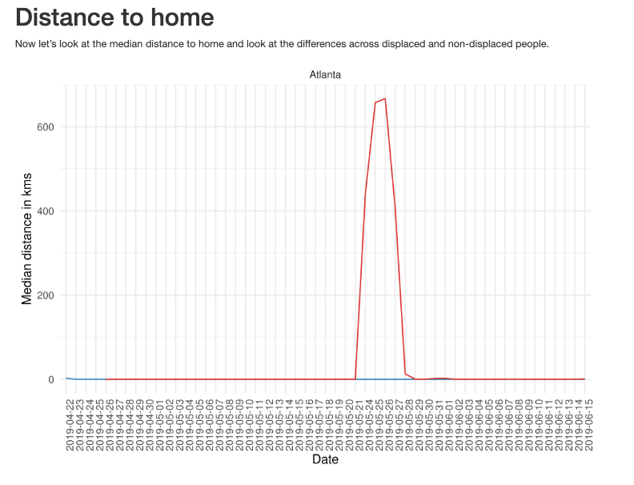
Cyclone Fani: Comparison to “Non-crises”
Memorial Day in Georgia (US)
Cyclone Fani
Non-crises show quick “recovery” and a more homogeneous pattern of “displacement.”

Slide 16
Conclusion
Disaster Maps is a close and continuous collaboration with humanitarian organizations to address key questions for those organizations.
Maps have been used in real-world settings for about 2 years to distribute relief supplies, reestablish connectivity, etc.
Our long-term displacement work with IDMC shows promising results, but this is work in progress!
We are actively looking for independent data sources to corroborate our measurements.

Slide 17
Thanks!
contact: shankar94@fb.com

