Slide 1
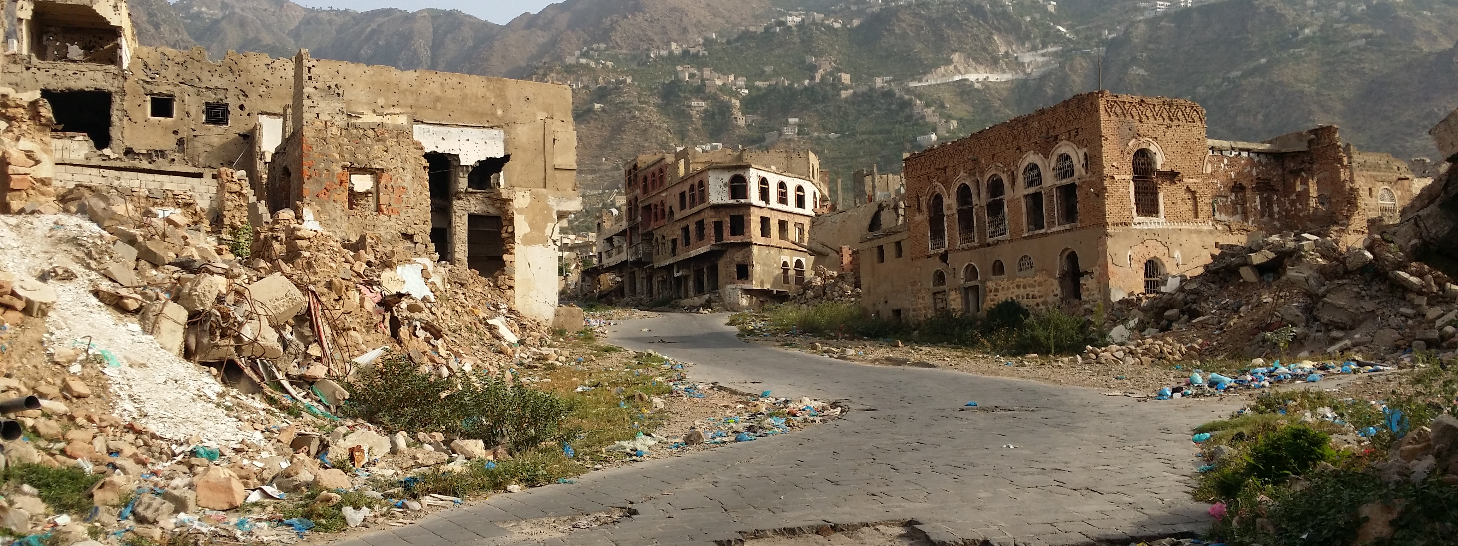
Yemen: urban displacement in a rural society
Evidence from Taiz and Aden

Slide 2
Setting the scene
Yemen’s urban-rural proportion: 36.6 % urban
Disaggregation of big displacement and conflict datasets
30.5% of Yemen’s IDPs are in urban areas (IOM dataset)
34.4% of conflict events took place in urban areas, 31.6% of recorded casualties were in urban areas (ACLED dataset)
Patterns of displacement
Rural-rural
Urban – urban
Rural-urban
Urban-rural

Slide 3
Urban IDPs
Half were from another urban area
Profile of urban IDP of rural origin
Future intensions
66% return
32% locally integrate

Slide 4
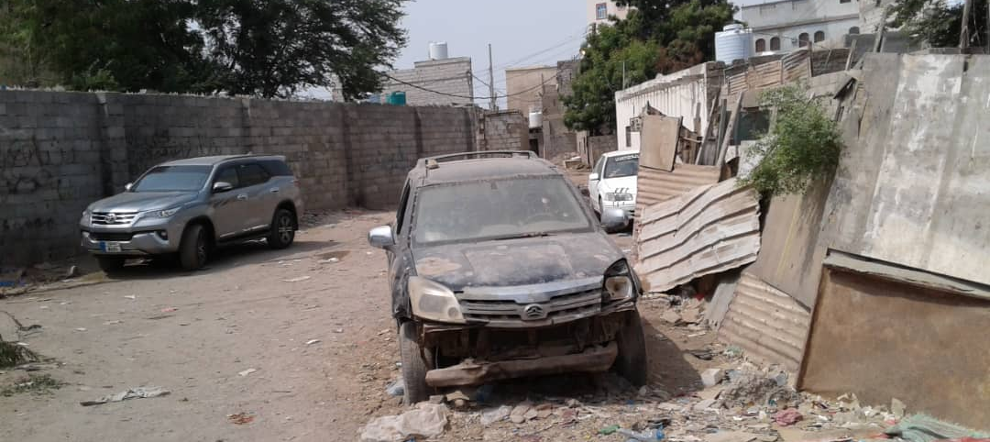
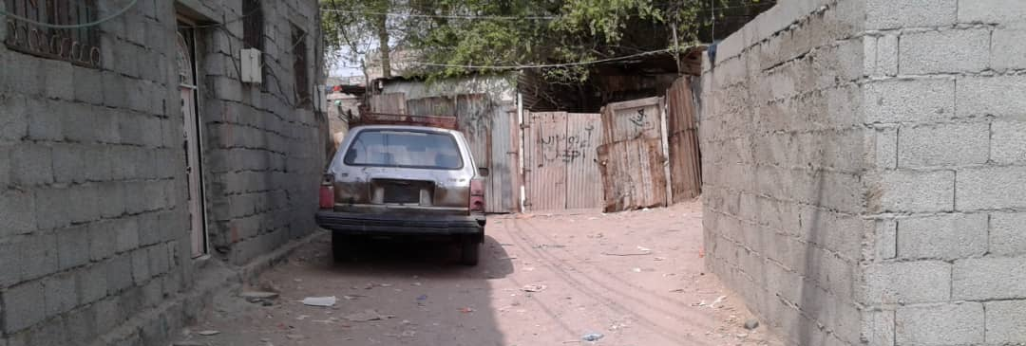
Conditions in urban displacement (Taiz, Aden)
Shelter
Water and electricity
Education and health

Slide 5
Finding local solutions
Nature of assistance to Yemen given the current context
Current examples of more long-term/sustainable programming
Issues to consider for future
Country’s rural conditions and pre-war urbanization trends
Patterns of displacement and conditions of displaced populations in urban centres

